Slide 1


Slide 2


Clean Architecture with ASP.NET Core 6
Steve Smith | @ardalis
Ardalis.com | NimblePros.com
steve@nimblepros.com

Slide 3

What is Clean Architecture
The architecture formerly known as…
Onion Architecture
Hexagonal Architecture
Ports and Adapters
A domain-centric approach to organizing dependencies

Slide 4


Two Common Approaches
N-Tier / N-Layer
Clean Architecture
UI
DB
UI
Infrastructure (inc. data access)
Business
Domain (Business)
Data Access
DB

Slide 5
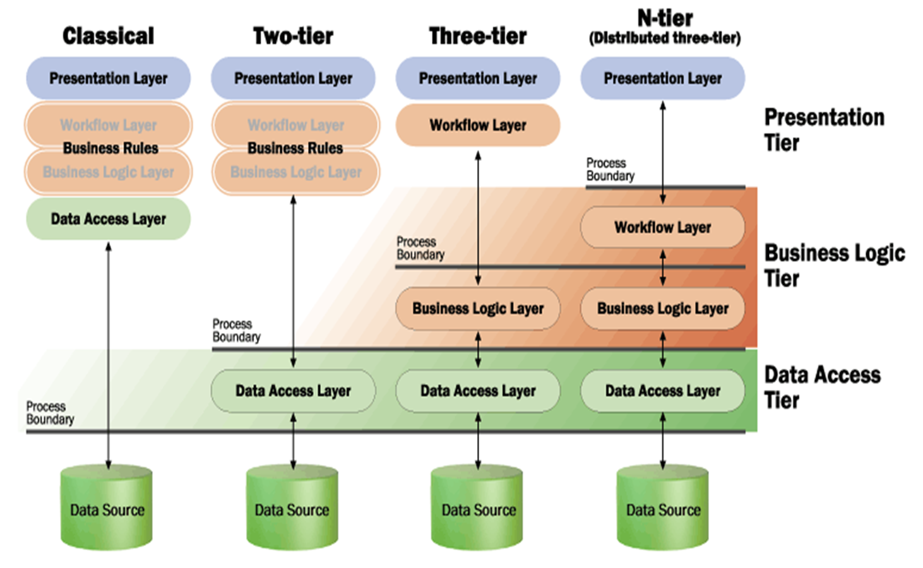

Slide 6
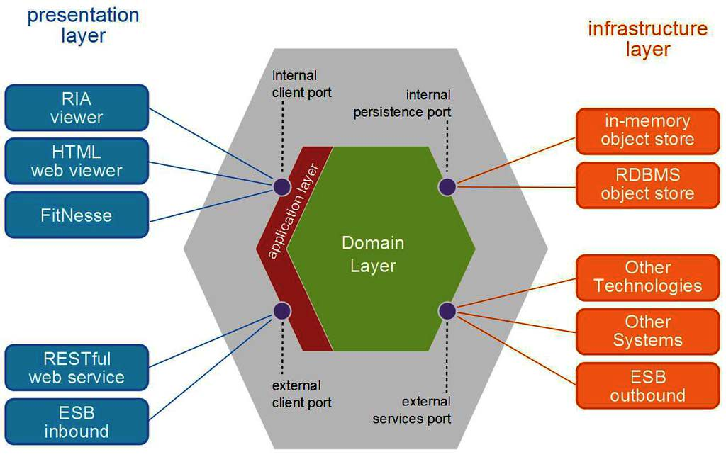

Slide 7

DB
Test DB
(SQLite, In Memory)
Web Project
Domain Model
And
Abstractions
Infrastructure Project
Core Project
Test Projects

Slide 8

Clean Architecture Rules
1
2
3
Model all business rules and entities in the Core project
All dependencies flow toward the Core project
Inner projects define interfaces; output projects implement them

Slide 9

What belongs in the Core project
Interfaces
Domain Events
Event Handlers
Aggregates
Entities
Specifications
Value Objects
Validators
Domain Services
Enums
Domain Exceptions
Custom Guards

Slide 10

Demo
An example Core project

Slide 11
What belongs in the Infrastructure project
Repositories
DbContext classes
Cached Repositories
API Clients
File System Accessors
Azure Storage Accessors
Emailing Implementations
SMS Implementations
System Clock
Other Services
Interfaces

Slide 12

Demo
An example Infrastructure project

Slide 13
What belongs in the Web project
API Endpoints
Razor Pages
Controllers
Views
API Models
ViewModels
Filters
Model Binders
Composition Root
Tag Helpers
Other Services
Interfaces

Slide 14

Demo
An example Web project

Slide 15

What about sharing code between applications?
Notes:
https://www.pexels.com/photo/photo-of-people-holding-pizza-3944307/

Slide 16
The Shared Kernel
Domain-Driven Design term
Holds common types shared between DDD apps
Typically reference by Core project(s)
Ideally distributed as NuGet Packages

Slide 17

What belongs in the Shared Kernel project
Base Entity
Base Value Object
Base Domain Event
Base Specification
Common Interfaces
Common Exceptions
Common Auth
Common Guards
Common Libraries
DI
Logging
Validators

Slide 18

No Infrastructure Dependencies
In Shared Kernel!

Slide 19

Demo
An example Shared Kernel project
and
Application Walkthrough

Slide 20

Thanks for joining!
Email me with questions: steve@nimblepros.com
Find my Clean Architecture Solution Template and more:
https://github.com/ardalis

Slide 21
Announcemnet
Value prop 1
Value prop 2
Value prop 3

Slide 22





Slide 23




Slide 24







Slide 25







Slide 26





Slide 27


Slide 28


Slide 29


Slide 30


